Slide 1
Wilson v. Fitzgerald
1947-1948
Streetcar to Bus Conversion
Background image: J Johnson

Slide 2
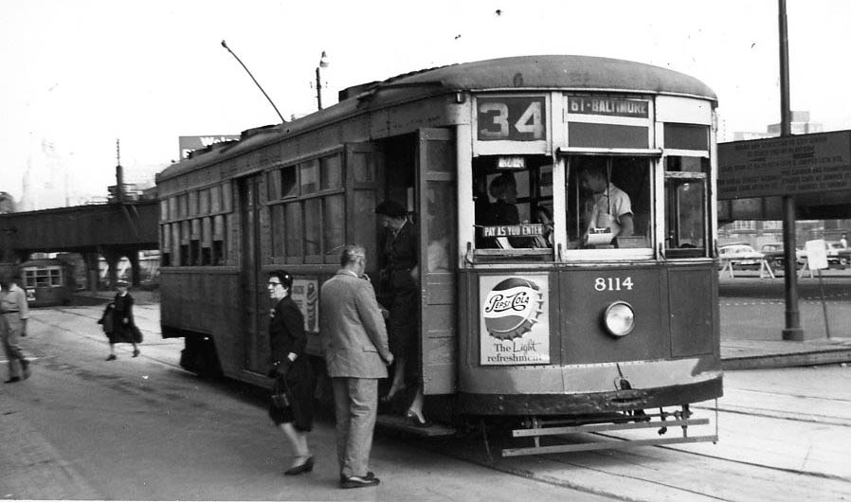
Baltimore Transit: A brief history
Image BSM holdings

Slide 3
Back to the future
1926
Bus vs. railroad lawsuits: Attitude of Public Officials toward Bus Competition
http://www.youtube.com/watch?v=1wEq0vFfxlo

Slide 4
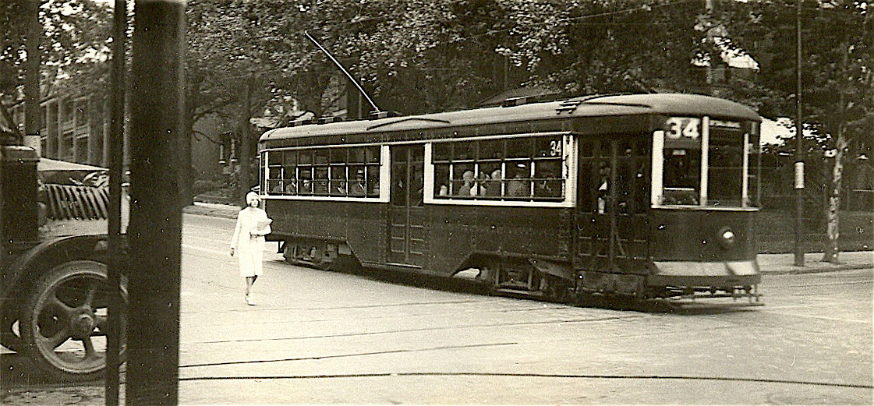
Baltimore Transit Company formed - 1936
Image BSM holdings

Slide 5
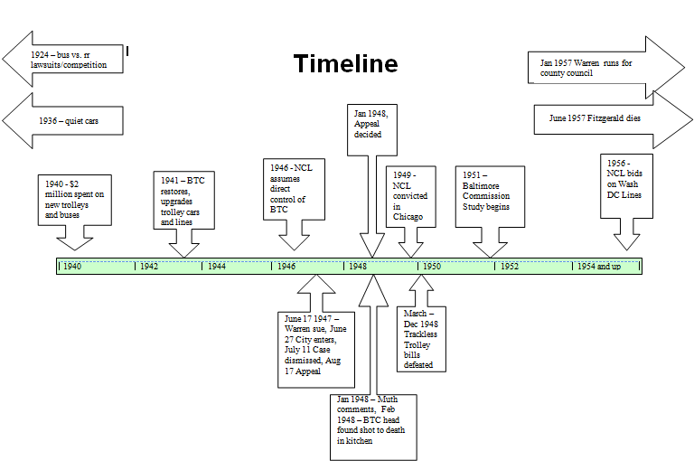

Slide 6
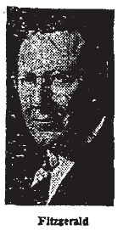
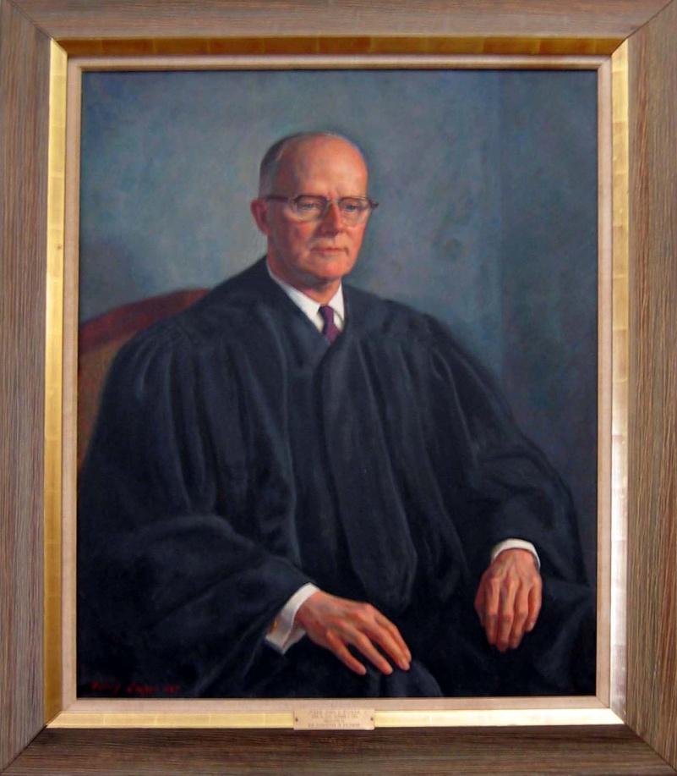
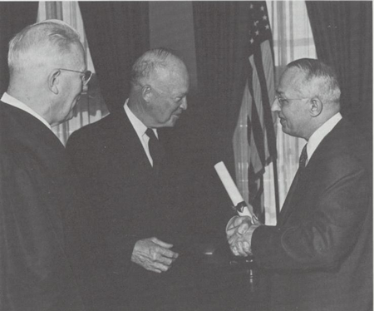
Tucker
June 1947 Lawsuit – Who’s Who
Images clockwise from left: Evening Sun, Chicago Tribune, and msa.md.gov (2)
Sobeloff
Notes:
Hon. John T. Tucker (1891-1967)
Henry Cooper (1907-2003)
Oil on canvas, 1967
47 ½ H x 39 ½ W in.
Presented, December 15, 1967
Donor, Baltimore City Bar Association
Owner, Baltimore City Circuit Court
Private Career:
Admitted to the bar, c.1915
Practiced in the firm, Carman, Tucker & Anderson
President, Eastern Shore Society of Baltimore City
Public Service:
Associate Judge, Supreme Bench of Baltimore City, 1943-1961
Comments:
Appointed to the Supreme Bench of Baltimore City by Governor Herbert R. O'Conor. Played a significant rule in the history of Maryland’s civil rights movement. In 1950, ruled that the actions of the University of Maryland at College Park were unconstitutional for barring Parren Mitchell from going to graduate school. The university tried to create a separate off-campus program where he would be the only student.
It was in the area of civil rights, however, that Sobeloff made his greatest mark. With increasing activism, he sought to secure equal treatment under the law for black Americans. Eisenhower nominated him for Senate, but Southerners opposed confirmation because of the nominee's views on civil rights – mostly Strom Thurmond

Slide 7
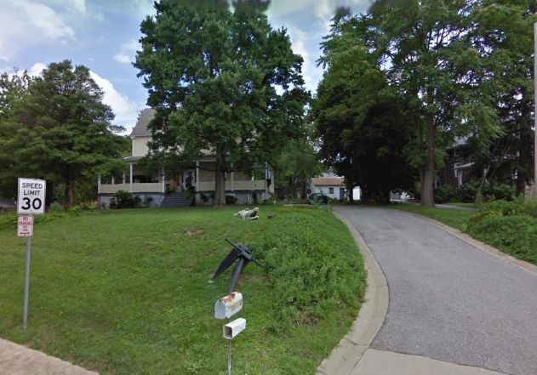
Wilson Warren

Slide 8
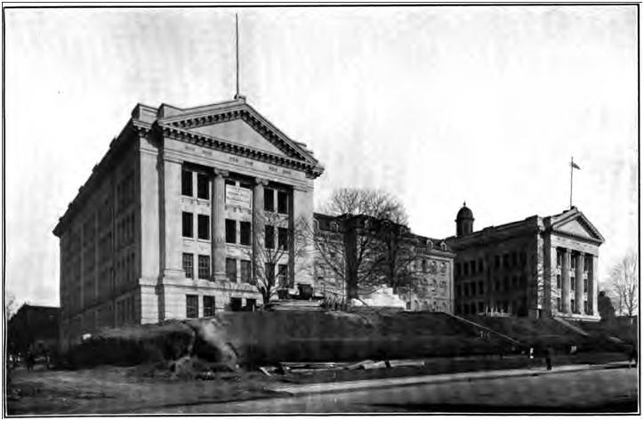
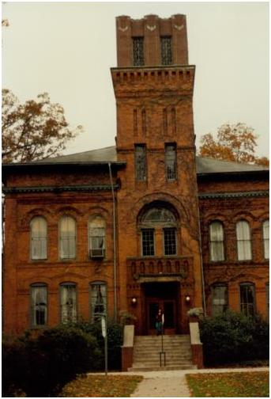


I am an “independent” independent

Slide 9
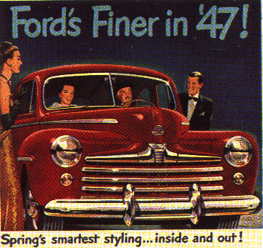
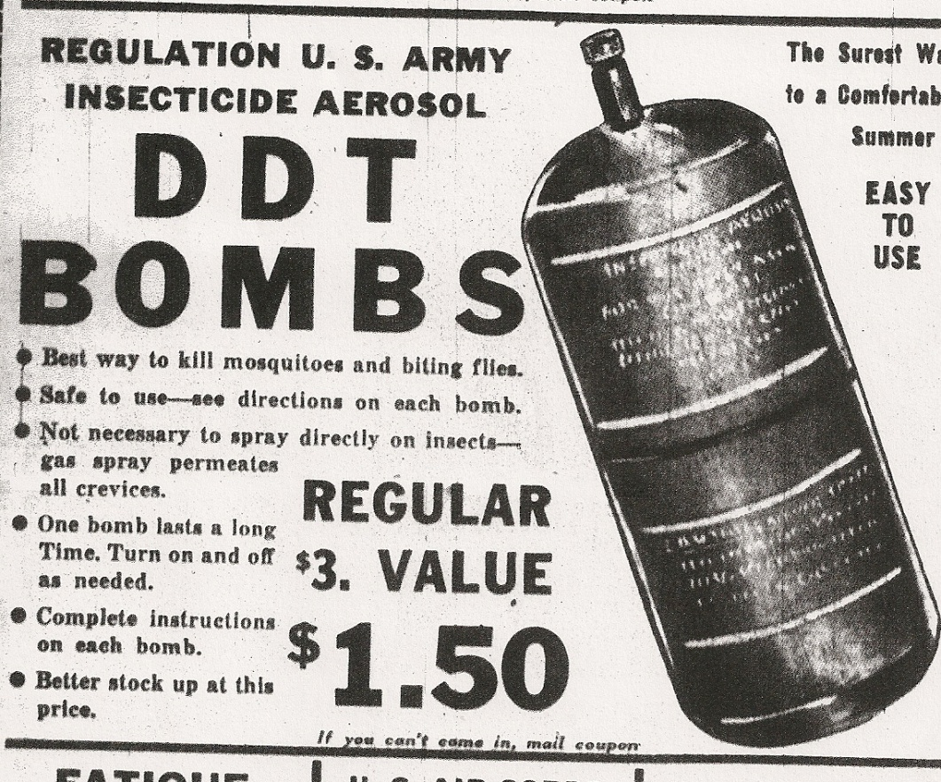
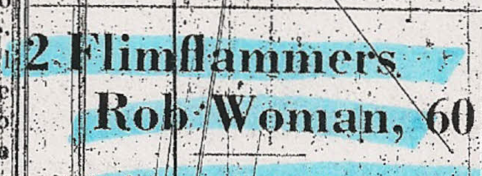
Time and Place
Images from left: Google open source, Baltimore Sun (2)
Notes:
Images:
Google open source
DDT: Baltimore Sun

Slide 10

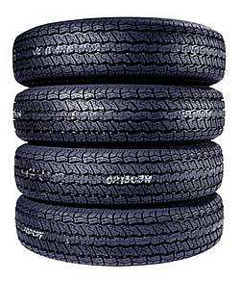
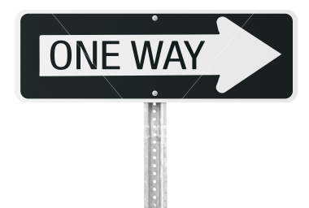


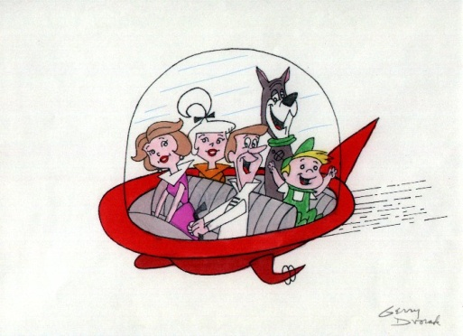
Influences and Factors
Images all Google open source, except Jetson image: http:// arstechnica.com/
Notes:
Images:
Google open source images
Jeston image: http://arstechnica.com/

Slide 11
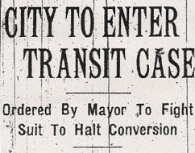
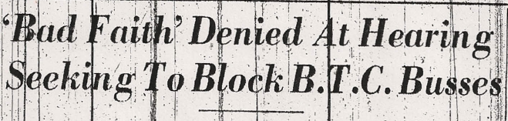
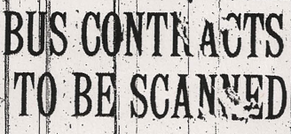
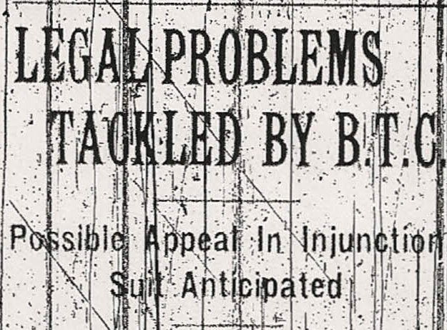
Case overview
Baltimore Sun

Slide 12
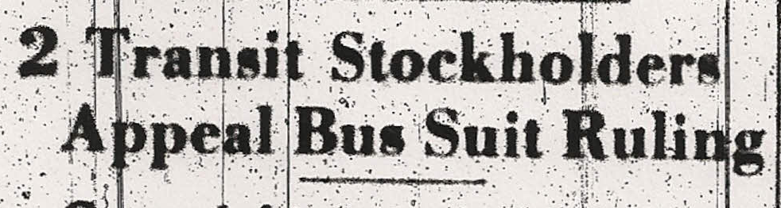
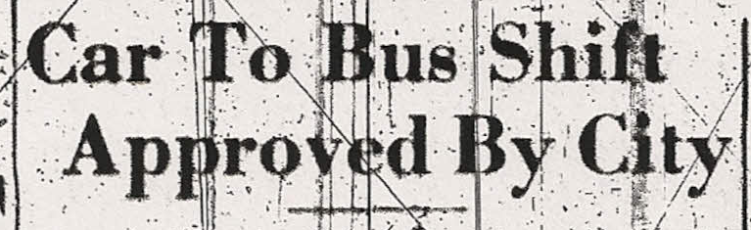
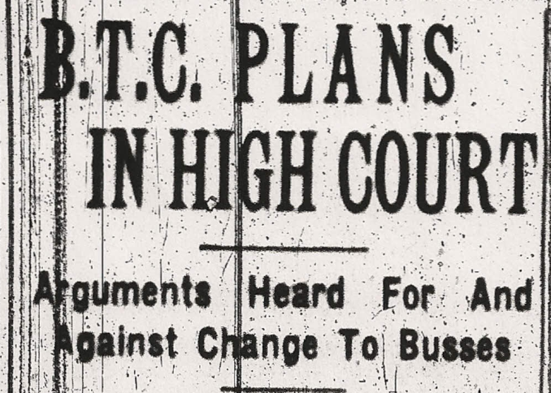
Appeal
Losses acknowledged
Previous judge said “keep trolleys in congested areas”
PSC reduced conversion percentage
Rail company should have some rails
Fraud/contract not behind original argument
It may not be wise, cost-effective or better, but it isn’t illegal
Baltimore Sun

Slide 13
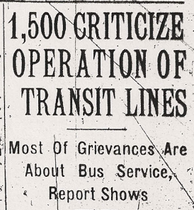
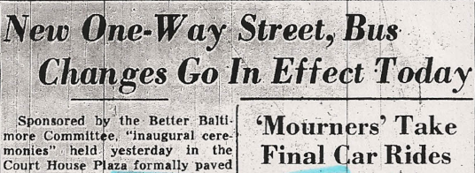
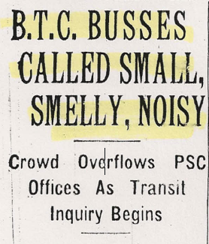
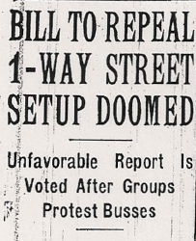
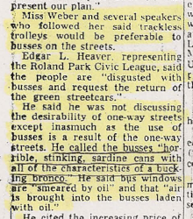
Public reaction

Slide 14
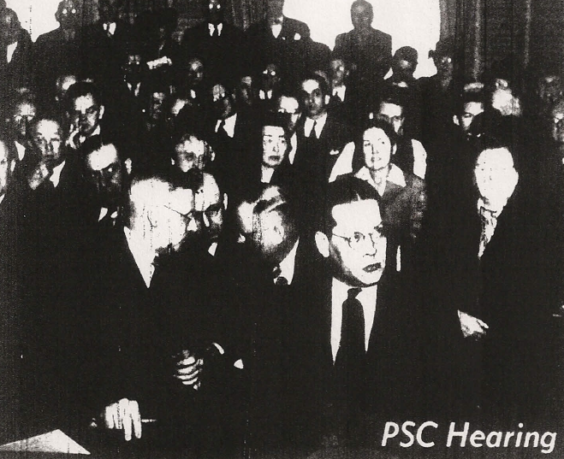
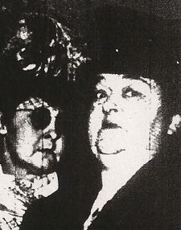
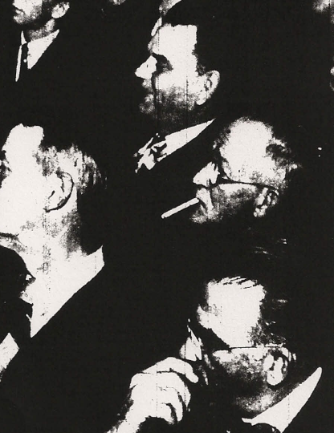
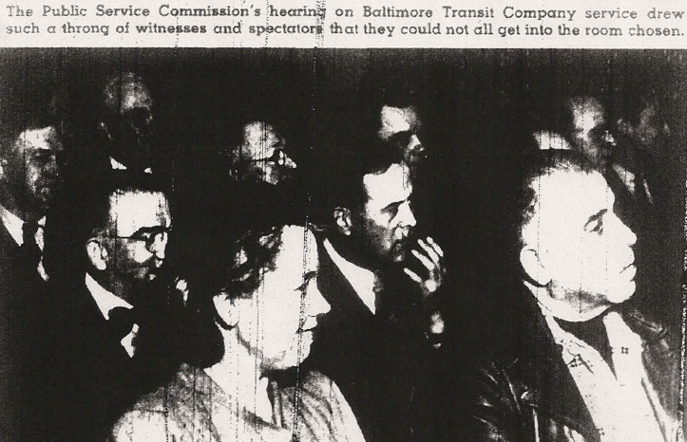
Public reaction - meetings

Slide 15
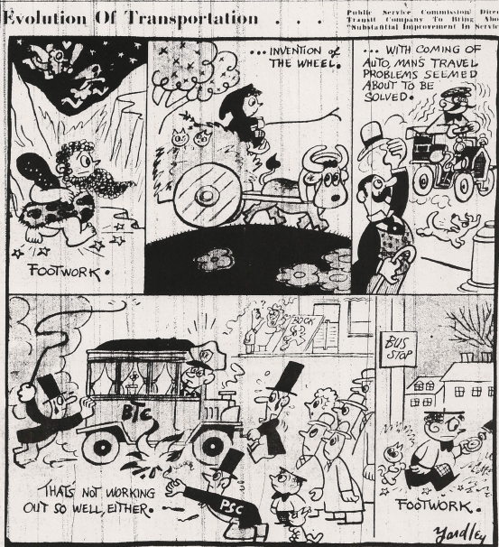

Slide 16
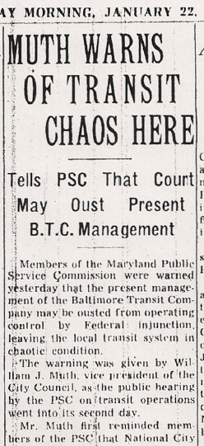
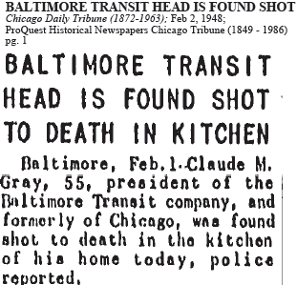
Connection?
Baltimore Sun

Slide 17
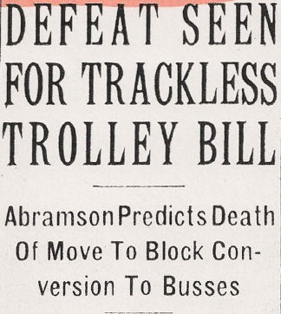
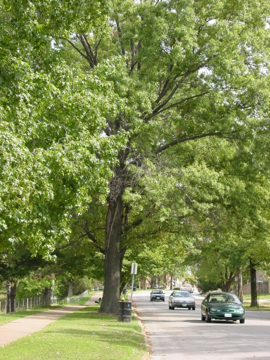
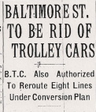
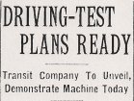

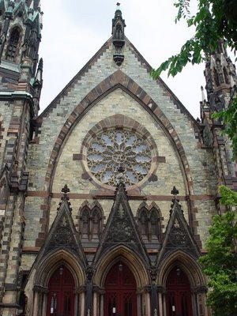


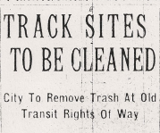
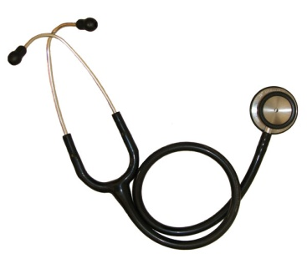

Impacts
Baltimore Sun
Google open source

Slide 18
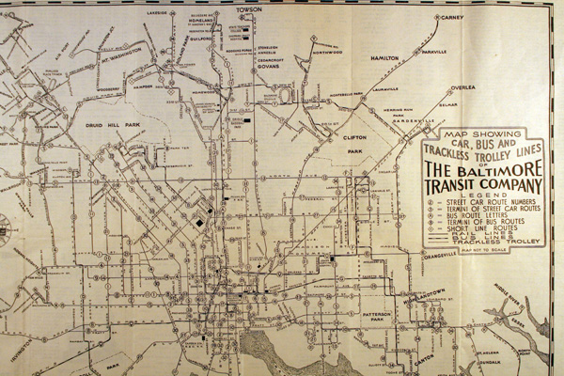
1941 Transit Map
http://www.library.jhu.edu/bin/b/r/streetcars.jpg
The last trolley took its last trip on Saturday February 27, 1954

Slide 19
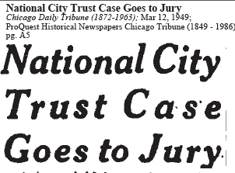
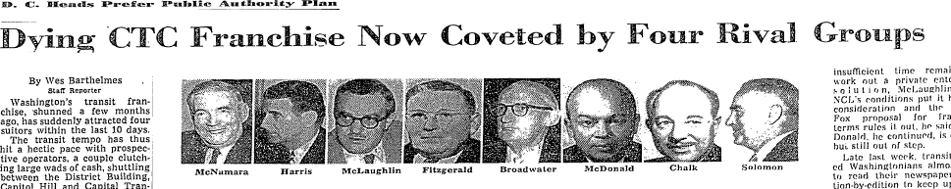
National City Lines Legacy
The Baltimore Commission began studying transit problems in the city in 1951 and in 1956 noted: We believe the Baltimore Transit Company would be in a healthier state if National City Lines Would pick up its marbles and go home.
Washington Post

Slide 20
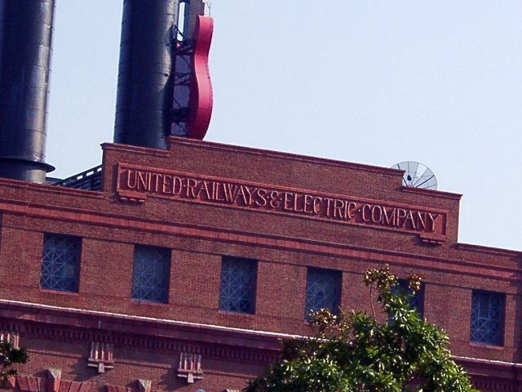
“The most heralded of the streetcar system's old power structures is the United Railways and Electric Power Plant”
http://www.monumentalcity.net/streetcars/row/

Slide 21
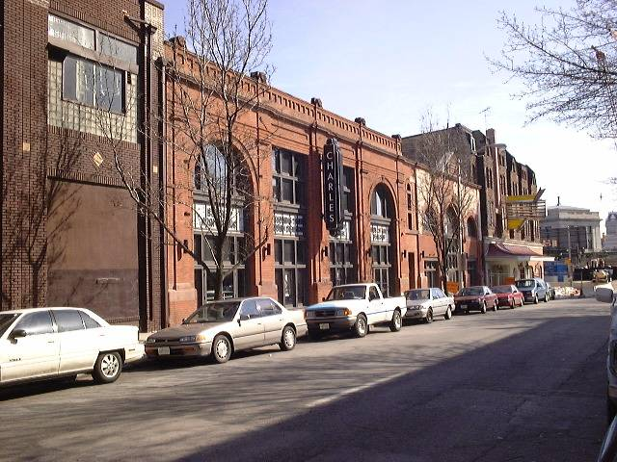
“The Charles Theatre, on Charles Street below Lafayette was originally a powerhouse for the city streetcars, and later a bus garage”
http://www.monumentalcity.net/streetcars/row/

Slide 22
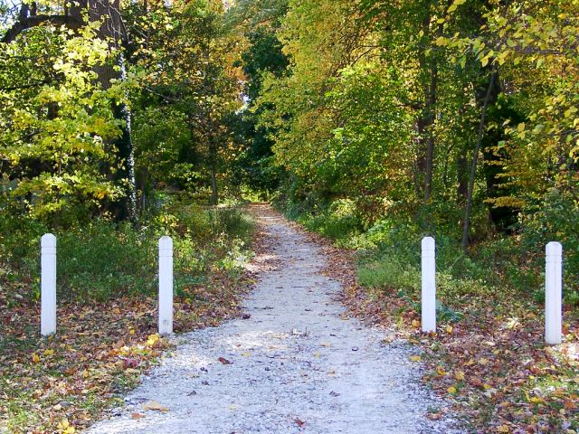
In Catonsville, the former right of way of the #8 car line held on long enough to be adopted by locals who upkept it to become the "#8 Trolley Trail."
http://www.monumentalcity.net/streetcars/row/

Slide 23
Environmental and policy legacy – lesson learned too late
Effective cities need effective public transportation:
Community
Business
Health
Investment

